Slide 1
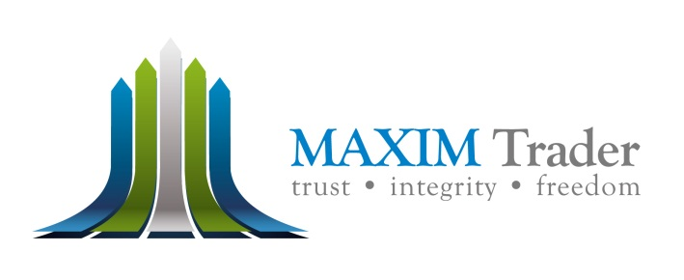
MAXIM Trader 美胜金融
A fund of funds 基金的资金

Slide 2




About MAXIM Trader
MAXIM Trader is registered in Auckland, New Zealand with the Financial Markets Authority as a financial services provider licence providing unique alternative investment solutions for financial advisors and their clients.
We believe that all retail investors should have access to the same sophisticated investment approach and superior portfolio management talent as the largest institutions.
A boutique alternative investment specialist MAXIM Trader offers a suite of innovative products designed to help financial advisors allocate to alternative investments.
WWW.MAXIMTRADER.COM

Slide 3

Geographical Footprints

Slide 4
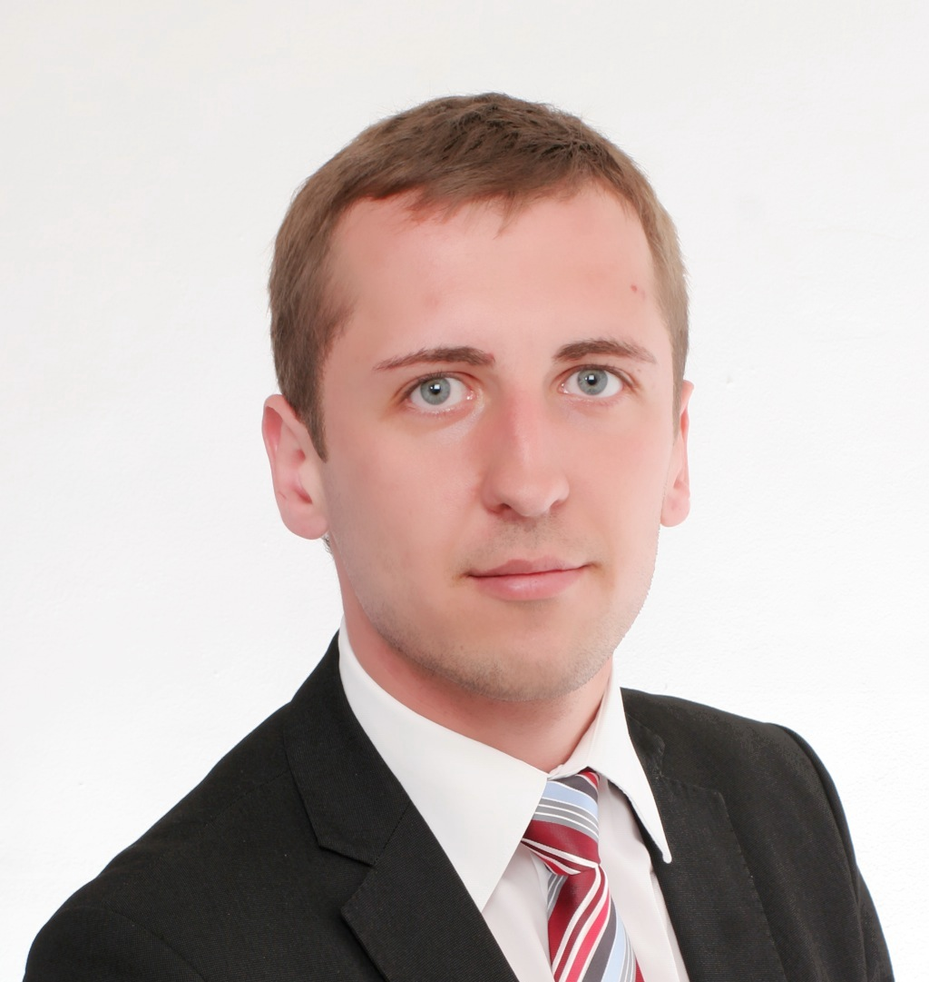
‘The Founders’ “创办人”
Mikhail Lebedev is a veteran of the financial industry with not less than 20 years trading, options and foreign exchange (FX) experience at various leading international financial institutions. Mikhail leads the strategic directions of the Company and monitors all of its business units from sales to finance. He serves on the Company’s Board of Directors as well. He joined Maxim Trader as a founding partner of the Company and as well as managing director, and assumed the Chief Executive Officer position soon after. Prior to founding the Company, Mikhail was head of and the managing director of United Kingdom equities trading at Natixis investment bank. In his role, Mikhail directly oversees a group of elite staff of more than 30 equities trading specialists and also played a crucial role as a member of Natixis's European Management Committee. During the early years, Mikhail was at Credit Suisse, where he was recruited as a EUR/CHF trader and was promoted to managing director and chief trader for spot and forward Currency Exchange in a short period of 5 years. Trought his time at Credit Suisse, Mikhail explored and learned the investment bank's fast-growing markets currency trading desk. During his time at Credit Suisse, he also served as the Central Bank of the United Kingdom Foreign Exchange representative for investment banks. Mikhail's London Stock Exchange experience career began at the age of 24 in the The Share Centre Company (UK). On top of his corporate responsibilities with Maxim Trader, Mikhail serves on the Financial Services Authority's Foreign Exchange Derivatives Advisory Committee and is a founding member of the Foreign Exchange Dealer's Coalition. Mikhail holds a B.S. in finance from St. Petersburg University and an M.B.A. in finance from the London School of Economics.
Mikhail Lebedev

Slide 5
Fund Management Strategies 基金管理策略
Alternative Strategies
The universe of fund management can be complex and are often misunderstood. Among the most common is the employment of alternative investment strategies.
However, not all alternative strategies are the same and each has unique characteristics that may result in out-performance or under-performance in various market conditions.
MAXIM Trader employs a combination of strategies that take advantage of the price movements of related and correlated underlying to maximize profit potentials. To enhance profitability, we develop and incorporate highly complex high-speed frequency algorithmic trading computer modeling in our daily trading modeling.

Slide 6
Alternative Strategies Architecture
Alternative Investment Strategies
Hedged Strategies
Private Investment Strategies
Opportunistic Equities
Enhanced Fixed Income
Absolute Returns
Tactical Trading
Long/Short Equity
Short Equity
Long/Short Sector
Long /Short International
Distressed Equities
Global /Emerging Market Debts
Structured Credit
Long/Short Credit
Leveraged Loans
Loan Origination
Equity Market Neutral
Convertible Arbitrage
Fixed Income Arbitrage
Statistical Arrbitrage
Event Driven
Commodities
Global Macro
Managed Futures
Tactical Trading
Self Directed
Precious Metals Derivatives
Energy & Natural Resources
Buyouts
Real Estate
Growth Capital
Venture Capital
Private Debt
Special Situations
Self Directed FOREX
Managed Precious Metals Derivatives
Managed FOREX

Slide 7
Tactical Trading
Tactical trading strategies generally speculate on the direction of price action of commodities, equities , bonds precious metals and currencies. Often managers will combine long and/or short positions with each strategy to maximize returns.
Top-down approach focusing on global macroeconomic shifts in which outright and derivative positions are taken.
Among the myriad of financial instruments that MAXIM Trader trades in are the global currency markets and cash market for gold.
These two markets are some of most liquid and volatile in recent years owing to the global financial crisis and it is for this very reason why these instruments are chosen. Using our in-house expertise, trading models are developed and vigorously tested and incorporated into our tactical trading strategies.

Slide 8
Managed Trading –
Maxim GOLD FX 美胜黄金外汇管理
GOLD
FOREX

Slide 9
Implementing Alternatives
By investing in MAXIM Trader alternative strategies, investors may achieve additional risk mitigation and potential return enhancement in today’s volatile markets.
At MAXIM Trader , we believe an alternative investments’ portfolio should provide exposure to both hedged strategies and private investments as a compliment to a traditional long-only portfolio like equities.

Slide 10
Fund Structure 基金结构
MYGP
MAXIM
Trader
MAXIM
Gold
MAXIM
FX
Subscribers

Slide 11
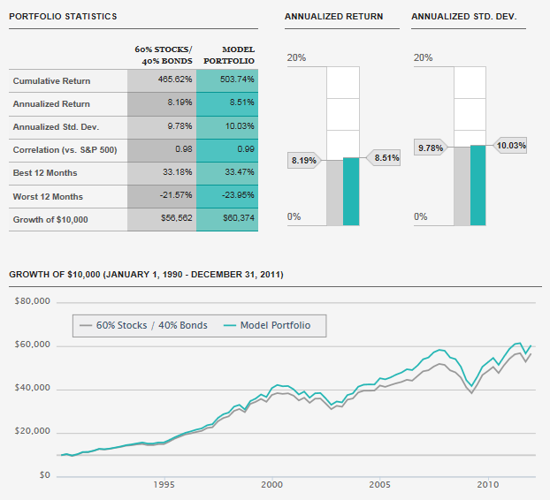
Managed Trading 管理营运
SAMPLE
* To be collaborated upon purchase of MT4

Slide 12
Managed Trading 管理营运
MAXIM Trader model portfolios are calculated using quarterly returns and rebalanced annually. Performance does not include fees, therefore returns for the portfolios would be lower due to the impact of fees and expenses not included here.
Past results are not indicative of future performance.
The hypothetical illustrations used are not intended to predict the performance of any specific investment or security. No assumptions should be made that similar asset allocations will be profitable, suitable, or perform as indicated above. Allocations and their percentages should change based on an individual investor’s needs.
The past performance figures do not represent performance of any MAXIM funds and there can be no assurance that any MAXIM funds will achieve the past returns of the illustrative examples.
Standard deviation is a measurement of the investment´s volatility.
Correlation is a statistical measure of how two securities move in relation to each other.

Slide 13
Management Fee 管理费
The management fee is the same as those in mutual funds. The difference is that MAXIM funds charge a management fee of 2% of assets managed.
Incentive Fee 奖励费
Most if not all fund managers charge an incentive fee of anywhere between 10-20% of fund profits, and some hedge funds have even gone as high as 50%. The idea of incentive fee is to reward the fund manager for good performance.
For example, if MAXIM Trader generates a 30% return per year, after management fee, we will collect 20% of those profits, leaving the investor with a 16% net return.
MAXIM Trader only collect the incentive fee for profits exceeding the hurdle rate, defined as the return on U.S. Treasuries, before any incentive fees is collected.
MAXIM Trader follow the so-called "two and twenty" structure – where managers receive 2% of net asset value managed and 20% of profits.

Slide 14
Redemption 赎回
Hedge funds do not have daily liquidity like mutual funds do. All MAXIM funds have daily subscriptions and monthly redemptions.
As the underlying strategies and investment instruments are very liquid as all O.T.C. foreign exchange and precious metals are and in order not to cause undue impact to the portfolios under management.
MAXIM funds have a cut-off date for redemption notices on the 15th day of the calendar month before the Dealing Date. Early redemption notices allows the hedge fund manager to efficiently balance his portfolio without compromising profitability of remaining funds under management.

Slide 15
Minimum Investment Period 最低投资期
Some funds require up to a three-five year "lock-up" commitment, but the most common lock-up is limited to one-two year.
It could be a hard lock, preventing the investor from withdrawing funds for the full time period, in other words an investor can’t withdraw funds before the expiration of the lock-up period.
All MAXIM funds have a minimum investment period of 18 month. (hard lock)

Slide 16
Performance Guarantee 表现担保
Should the investor choose the investment portfolio with this guarantee offer, he/she is offered a percentage of 1-20% of the current capital on a monthly basis. After the agreed time has been fulfilled, the agreement is no longer valid and the guaranteed performance guarantees will no longer be paid to the investor. This guarantee is ideal for investors who are looking at a longer term period of investments with low risk. However, there are terms and conditions which are stated within this guarantee agreement.
Capital Guarantee 资金担保
Under this agreement, the investor will have a guarantee provided by the broker, stating that in the event the returns on investment is less than the initial capital invested after an agreed time; the broker shall compensate the investor the initial capital which was invested. However, there are terms and conditions which are stated within this guarantee agreement.

Slide 17
Parental Guarantee 母公司担保
What if for every principal dollar an investor put in, there is a corresponding value of an asset pledged in the investor’s name?
This can be in the form of shares of a public listed company of the parent company. What this means is that for every dollar an investor commits to a managed fund program, shares equals to the value invested are issued or pledged in his/her name. In the unlikely event that something untoward happen to the fund manager, the investors still have in his/her hands shares of the parent company in which to mitigate his/her risks.
In this regards, MAXIM Trader’s managed funds are individually and severally insured in the form of a parental guarantee provided by its parent company MY Group Inc, (MYGP: OTCQB) a public listed financials/Investment trusts company in the bulletin board of the NASDAQ in the U.S.
Specifically, every dollar invested by an investor is backed by a corresponding share of the parent company. With this unique arrangement, investors have the comfort and knowledge that in the unlikely event of insolvency of any of MAXIM Trader managed portfolios, they have in their hands the shares of a public listed company in which they can use to mitigate such risks.

Slide 18
MAXIM Trader 美胜金融
MaximTrade Executor™ 交易软件

Slide 19

MaximTrade Executor™
交易软件
MAXIMTRADE EXECUTOR™ is a combination of automated trading with interventions by a team of expert fund managers with more than 15 years track record specializing in Forex investments. One and a half years of investment and tireless research by our dedicated fund managers using sophisticated programing language and advanced coding that can prevent any attempts to try and decode the logic, they developed the ultimate solution for investors.
Today, MAXIMTRADE EXECUTOR™ is an internationally recognized trading system that performs automated trading with extreme accuracy. It scans the past history of the MetaTrader4 and adjusts its strategy according to the current market conditions and recent changes. With the combination of the fund manager’s experience and constant tweaking to the market conditions, it maximizes the profits for the clients whilst minimizing the risk in trading operations.

Slide 20
交易软件
MaximTrade ExecutorTM
从3000万美金资金，到了2011年7月份，已经达到1.2亿美金的辉煌纪录！
自2009 年，本公司已经开始使用了
MaximTrade ExecutorTM
的智能交易软件。
(MaximTrade = Maximum trade)
可使用 MT4 策略测试来观察策略的实用性和透明性

Slide 21
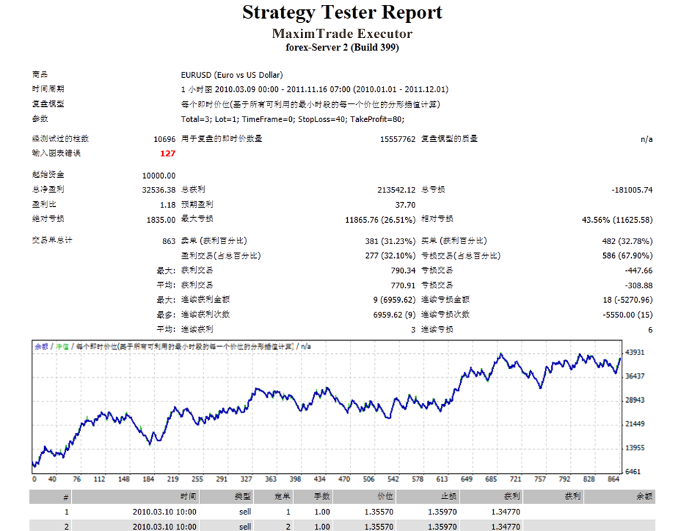
交易软件
MaximTrade Executor TM
可使用 MT4 策略测试来观察策略的实用性和透明性

Slide 22
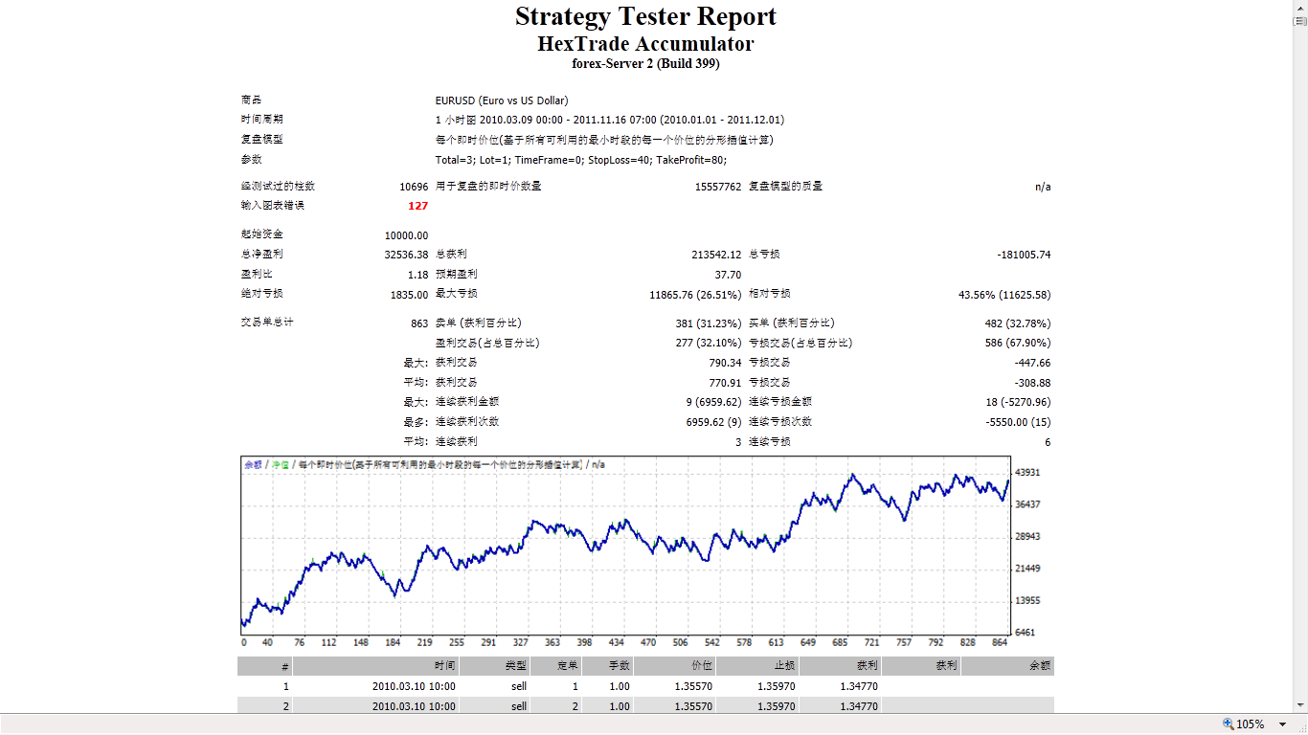

交易软件
MaximTrade Executor TM
MT4 交易记录
2010.3.1 – 2011.11.16 EURUSD
10000 USD 资金启动，净利润 32536 USD！
* 余额 42536 USD

Slide 23
长期回馈计划
（美胜补加100%）
总交易金额
入金
10000 USD
20000 USD
每交易 200 手后
XXXX USD
可提款10% 的余额
提款 无时间限制，
只需要交易量。
交易 2000 手后
XXXX USD
可全额提款

Slide 24
长期回馈计划
入金 10,000 美金
交易 200 手后
（平均两个月后）
没盈利或亏损的情况下
户口余额 = 20,000 美金
提 10% = 2,000 美 金
2,000 美金=
入金成本的 20%
提5 次 就 100% 回本 ！！！

Slide 25
MAXIM Trader 美胜金融
Packages & Compensation Plan 配套 & 奖金制度

Slide 26
Packages 配套
Package 配套 | Entry (USD) 金额（美元）
Elementary School 初级配套 | 1,000
Middle School 中级配套 | 5,000
High School 高级配套 | 10,000

Slide 27
Forex Bonus Promotion
外汇点数优惠
MaximTrade Executor™ 交易软件
Package 配套 | Initial Point 原有点数 | Bonus Point 送点数 | Minimum Lot Traded ** 最低交易次数**
Elementary School 初级配套 | 1,000 | +500 | 200手
Middle School 中级配套 | 5,000 | +3,000 | 1000手
High School 高级配套 | 10,000 | +10,000 | 2000手
USD1 : 1 Forex Point 1个外汇点数相等于1美元
**Each package must achieve the required no of lots (the minimum lot traded) in order
to WITHDRAW all the fund in the account
**每个配套必须交易特定的次数（最低交易次数），方能取得全额的总投资回酬（投资额+优惠点数）。

Slide 28
NOTE:
Every package has OWN Live MT4 Account ID
Deposit (Initial Point) appear in the MT4 BALANCE
Bonus Point appear in the MT4 CREDIT
One name can purchase multiple a/c with different user name (Different MT4 ID will be given)
Position Upgrading
Upgrade same a/c with New Package Purchase can be done within 60 days from the joined date (New MT4 ID will be given)
Interruption
The MT4 a/c can be interrupted for SELF TRADING.
Refund Policy
Package is refundable within 30 day from the joined date with TERMINATION OF ACCOUNT.
The refund will be 50% of the purchase package (All the trading profit will be forfeited) after deduct all bonus paid to the account.

Slide 29
Managed Fund - Maxim Gold FX
美胜黄金外汇管理
Maxim Gold FX Fund 美胜黄金外汇基金
Package 配套 | Entry (USD) 金额（美元） | Maximum Investment Amount(USD) 最大投资额 (美元）
Elementary School 初级配套 | 1,000 | Up to 到 5,000
Middle School 中级配套 | 5,000 | Up to 到 25,000
High School 高级配套 | 10,000 | Up to 到 50,000
Maxim Gold Fx Fund Purchase, 美胜黄金外汇基金购买 :
Management Fee - 2% 管理费 - 2%
Incentive Fee – 20% 奖励费 – 20%
Minimum Investment Period -18 month 最低投资期 -18个月
Capital Guarantee 资金担保
Parental Guarantee 母公司担保
Performance Guarantee - percentage of 1-20% of the current capital on a monthly basis
表现担保 - 当前资本的1-20％的比例按月

Slide 30
NOTE:
Client will have Live MT4 Account ID for Maxim Gold FX (New MT4 ID will be given)
Deposit (Investment Amount) appear in the MT4 CREDIT (hard lock – 18 months)
Profit appear in the MT4 BALANCE (Anytime Withdrawal)
Interruption
The MT4 a/c can be interrupted for SELF TRADING.(Master Password is given)
Profit Allocation
For clients who deposited between 1st-15th of any month, the amount of profit will be determined based on the available credit left on the relevant account on 16th of the following month and will be credited into client’s MT4 BALANCE account.
For clients who deposited between 16th-31st of any month, the amount of profit will be determined based on the available credit left on the relevant account on 1st of the next next following month and will be credited into client’s MT4 BALANCE account.
Client allow to Withdrawal MT4 Balance account fund ANYTIME
Refund Policy
Package is refundable within 30 day from the deposited date with TERMINATION OF ACCOUNT.
The refund will be 50% of the deposited fund amount (All the trading profit will be forfeited) after deduct all bonus paid to the account.

Slide 31
Compensation Plan
奖金制度
1) Direct Sponsor Bonus 直接推荐奖金
Package 配套 | Direct Sponsor Bonus 直接推荐奖金百分比
Elementary School 初级配套 | 8%
Middle School 中级配套 | 9%
High School 高级配套 | 10%
Calculation based on Sponsor Tree 根据直接推荐组织图计算
Daily calculation 每日计算

Slide 32
NOTE:
Direct Sponsor Bonus 10% 直接推荐奖金 10%
(Optional)
For example :
Balance 2% pass up
10%
100% pay out
8%
10%

Slide 33
Compensation Plan
奖金制度
2) Pairing Bonus 配对奖金
Package 配套 | Pairing Bonus 配对奖金百分比 | Daily Max 每日收入封顶
Elementary School 初级配套 | 10% | 1,000
Middle School 中级配套 | 10% | 5,000
High School 高级配套 | 10% | 10,000
Calculation based on Placement Tree 根据安置组织图计算
Daily calculation 每日计算
Once reach Daily Maximum, all accumulated SMALL GROUP point will be FLUSHED
只要达到每日收入封顶，所有累积小组业绩将归零

Slide 34
NOTE:
Pairing Bonus 10% 配对奖金 10% (Optional)
u
For example – point calculation
The pay out according to the point volume daily
(1 point = 0.50 – 1.00)
A
B
200K
20K
X 10%
= 2000 point
X 0.90
(point volume of the day)
= Income USD 1800

Slide 35
Compensation Plan
奖金制度
3) Pips Bonus 代数奖励（水钱）
Company allocates 10% of each standard lot traded each level up to 10 level
公司将从每一笔的外汇投资交易中，提拔1手（10美元），充作代数奖金。
No of Direct Sponsor 直接推荐人数 | 1 | 2 | 3 | 4 | 5
Level 1 第1代 | USD 1 美元 | USD 1 美元 | USD 1 美元 | USD 1 美元 | USD 1 美元
Level 2 第2代 | USD 1 美元 | USD 1 美元 | USD 1 美元 | USD 1 美元 | USD 1 美元
Level 3 第3代 |  | USD 1 美元 | USD 1 美元 | USD 1 美元 | USD 1 美元
Level 4 第4代 |  | USD 1 美元 | USD 1 美元 | USD 1 美元 | USD 1 美元
Level 5 第5代 |  |  | USD 1 美元 | USD 1 美元 | USD 1 美元
Level 6 第6代 |  |  | USD 1 美元 | USD 1 美元 | USD 1 美元
Level 7 第7代 |  |  |  | USD 1 美元 | USD 1 美元
Level 8 第8代 |  |  |  | USD 1 美元 | USD 1 美元
Level 9 第9代 |  |  |  |  | USD 1 美元
Level 10 第10代 |  |  |  |  | USD 1 美元
Own account entitle for Pips Rebate of 10% from each standard lot traded
当自己户口做每一手的交易将获取1美元回扣
Calculation based on Sponsor Tree 根据直接推荐组织图计算
Monthly calculation 每月计算1次

Slide 36


